Slide 1
ANOVA
Analysis of Variance

Slide 2
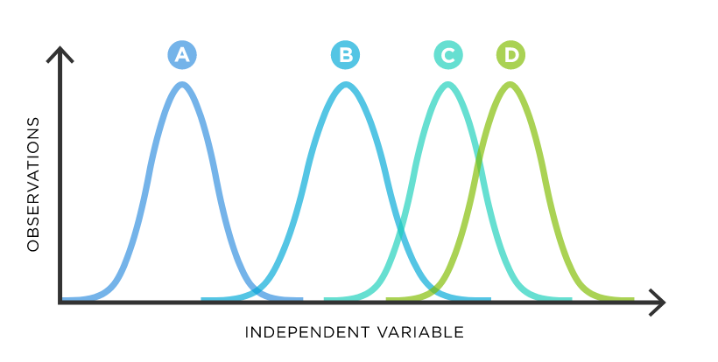
ANOVA Basics
Similar to Z / T testing, but with multiple groups simultaneously
One or more “factors” / variables
Each factor contains two or more levels
Levels can be numerical or categorical

Slide 3
One Way ANOVA
Used to detect significant differences among means values of three or more groups
Assumptions:
Populations are normally distributed
Populations have equal variances
Samples are randomly and independently selected

Slide 4
One Way ANOVA
H0: Group 1 Mean = Group 2 Mean = Group 3 Mean
HA: At least one of the group means is different to a statistically significant extent from the others

Slide 5
Variation
Total Variation (SST) = Within Group Variation (SSW) + Among Group Variation (SSA)
Sum Of Squared Variation Within Groups (SSW)
Calculate the mean of each group
Calculate differences between each observation and its group’s mean
Square the differences
Add up all the squared differences = SSW
Sum Of Squared Variation Among Groups (SSA)
Calculate the mean for all observations (grand mean)
Calculate the mean for each group
Calculate the differences between each group’s mean and the grand mean
Square the differences
Multiply each group’s squared difference by the number of observations in each group to weight the values
Add up all the multiplied squared differences = SSA

Slide 6
Mean Squares and the F Statistic
Mean Square Among (MSA) = SSA / (c - 1), where c is the number of categories
Mean Square Within (MSW) = SSW / (n - c), where n is the total sample size from all groups and c is the number of categories
F Statistic = MSA / MSW

Slide 7
F Statistic vs F Critical Value
Select a level of confidence
c = number of categories
Consult an F table for that level of confidence where df1 = c - 1 and df2 = n - c
α
0
Do not
reject H₀
Reject H₀
F_{α}

Slide 8
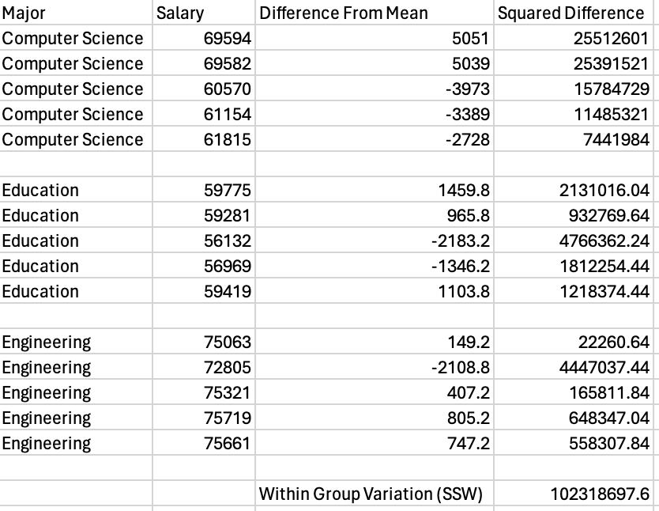
Example SSW
Calculate mean of each group
Calculate each observations difference from it’s group mean
Square the differences
Sum them up!

Slide 9
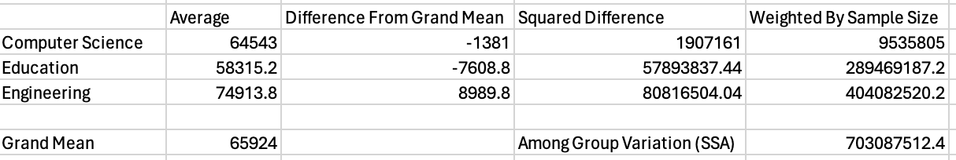
Example SSA
Calculate group averages and overall average (grand mean)
Subtract grande mean from each group average
Square the differences
Sum them up!

Slide 10
Example SSA and SSW
Mean Square Among (MSA) = SSA / (c - 1), where c is the number of categories
Mean Square Within (MSW) = SSW / (n - c), where n is the total sample size from all groups and c is the number of categories

Slide 11
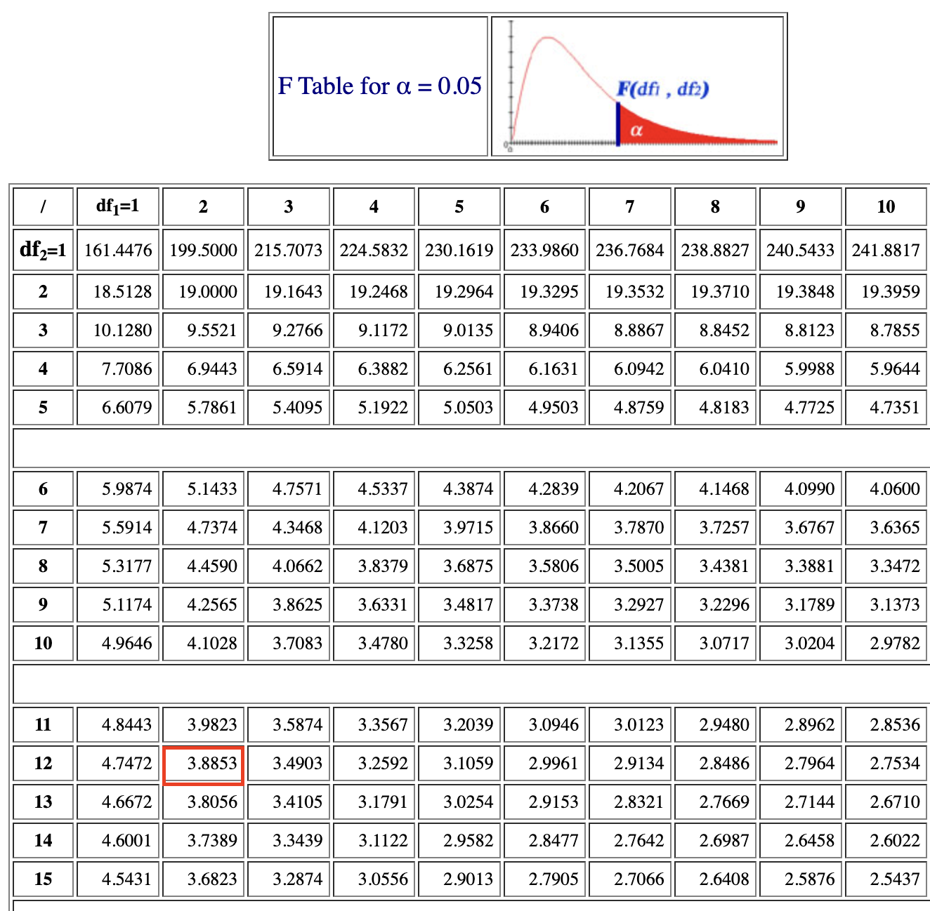
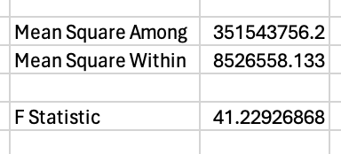
Example F-Statistic and Critical Value
Mean Square Among (MSA) = SSA / (c - 1), where c is the number of categories
Mean Square Within (MSW) = SSW / (n - c), where n is the total sample size from all groups and c is the number of categories
Consult an F table for that level of confidence where df1 = c - 1 and df2 = n -
F Statistic = MSA / MSW
Since F > CV, reject the null hypothesis that all group means are equal.

Slide 12
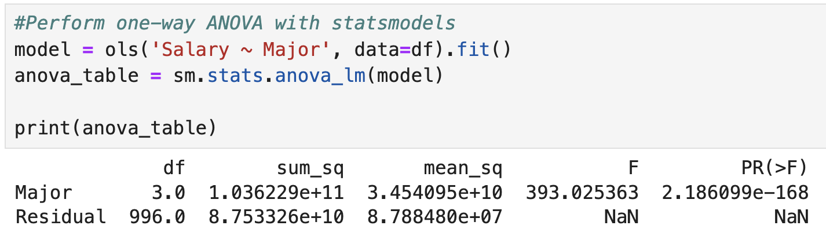
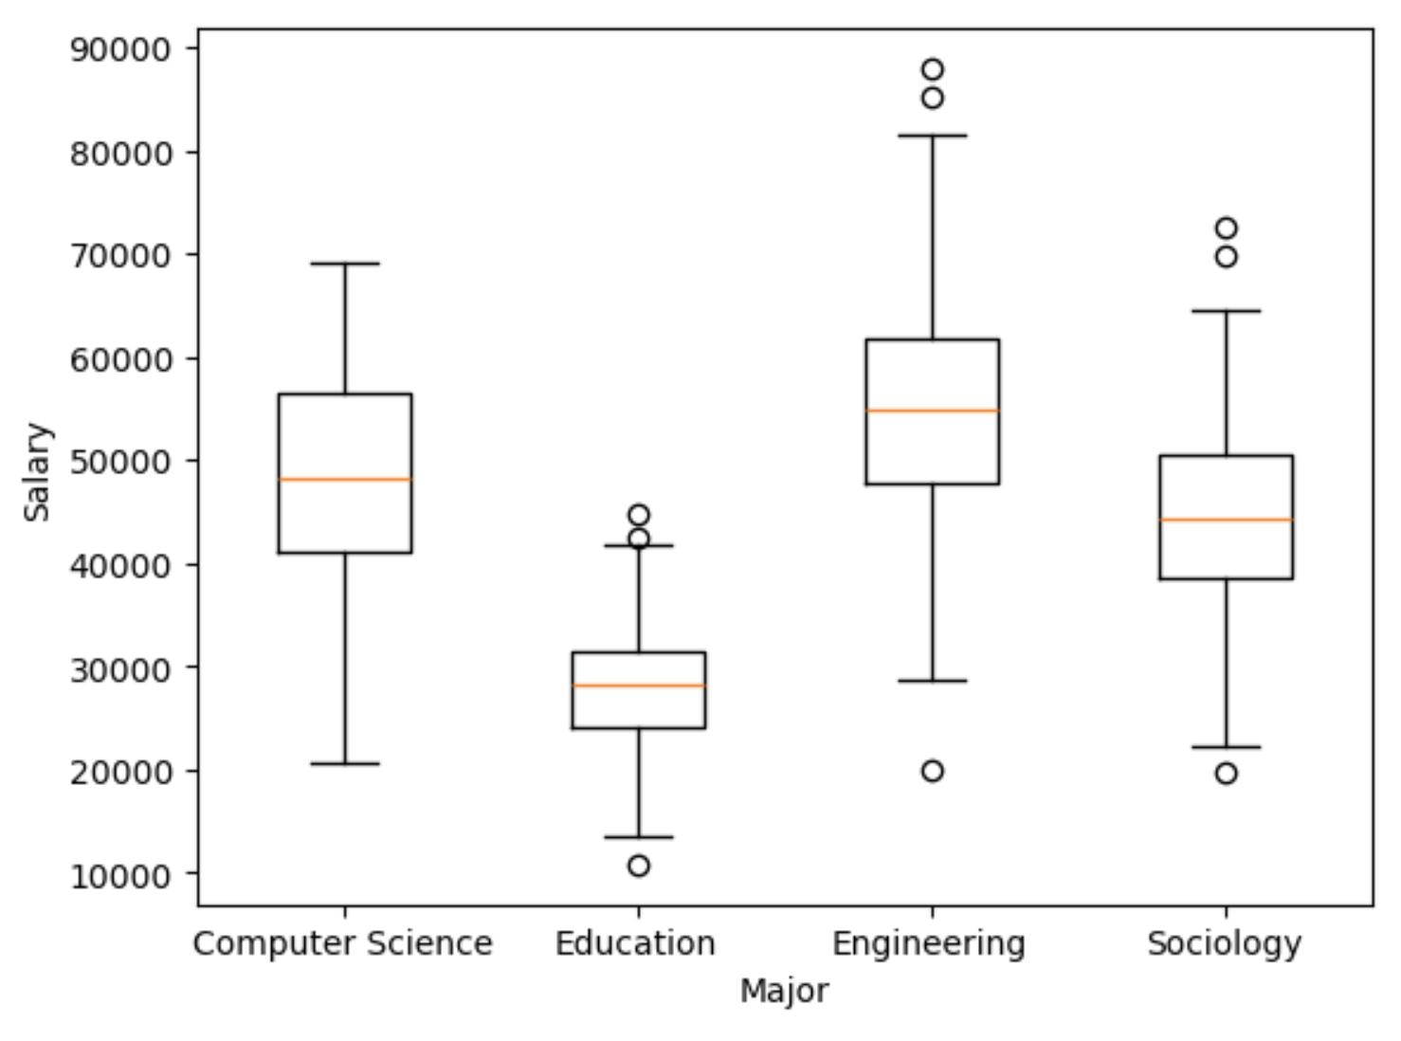

Slide 13
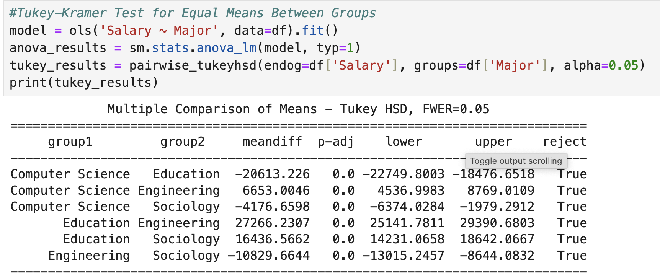
Tukey-Kramer

Slide 14
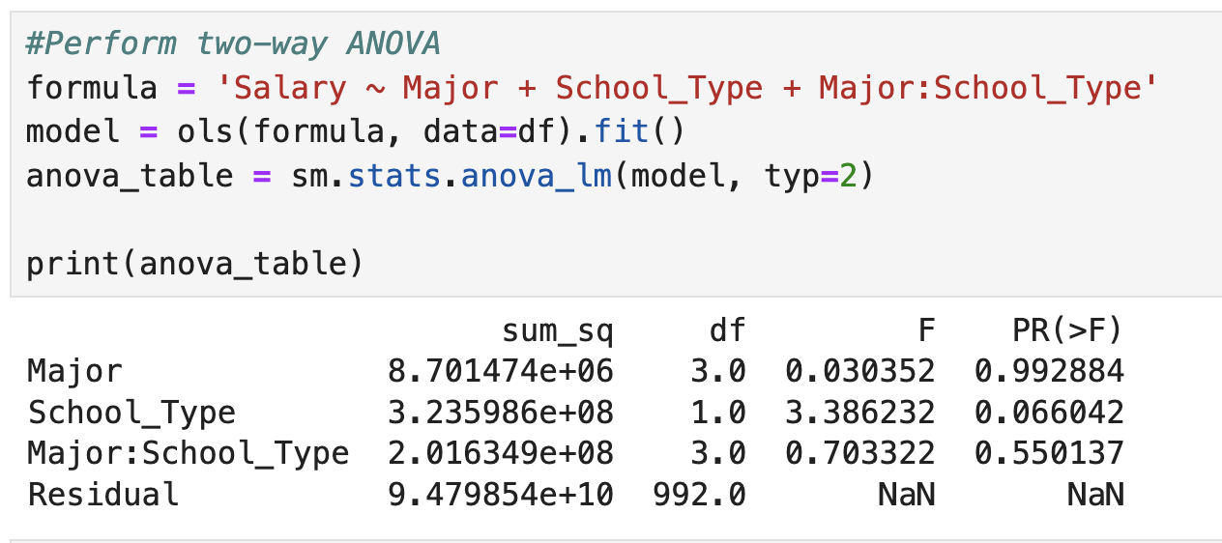
Two Way ANOVA
Used when there are two factors
Math gets a lot more tedious
Can also test for interaction effects between factors
Example interaction: Does choice of major affect salaries differently for private school students than it does for public school students

Slide 15
